Slide 1
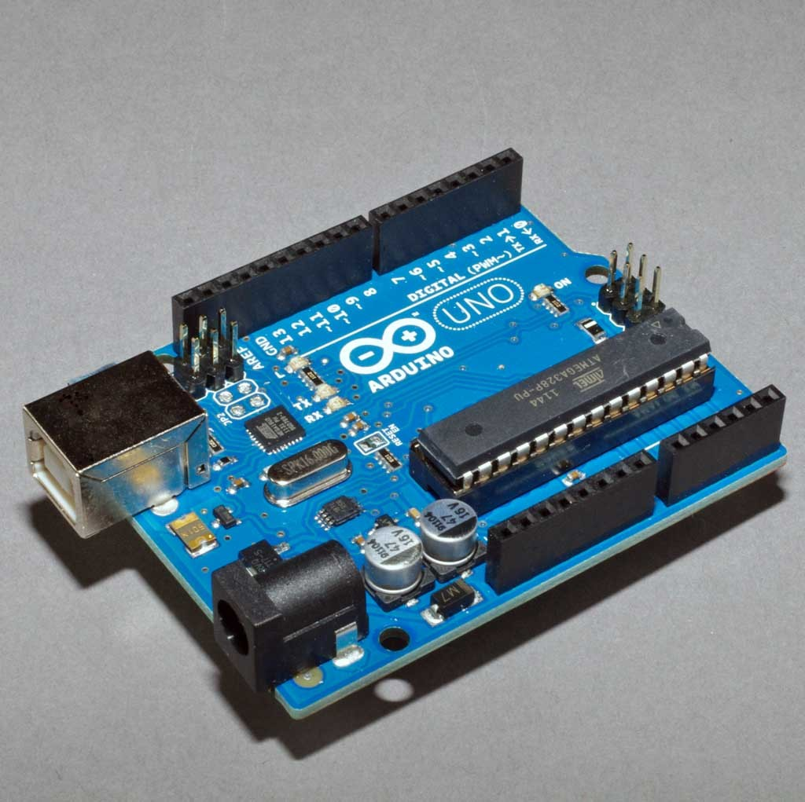
Introduction to Arduino

Slide 2
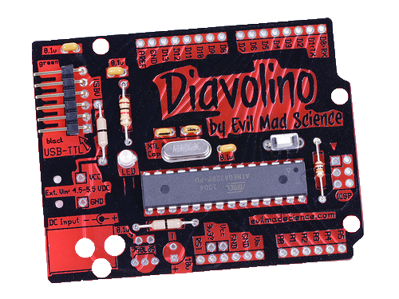
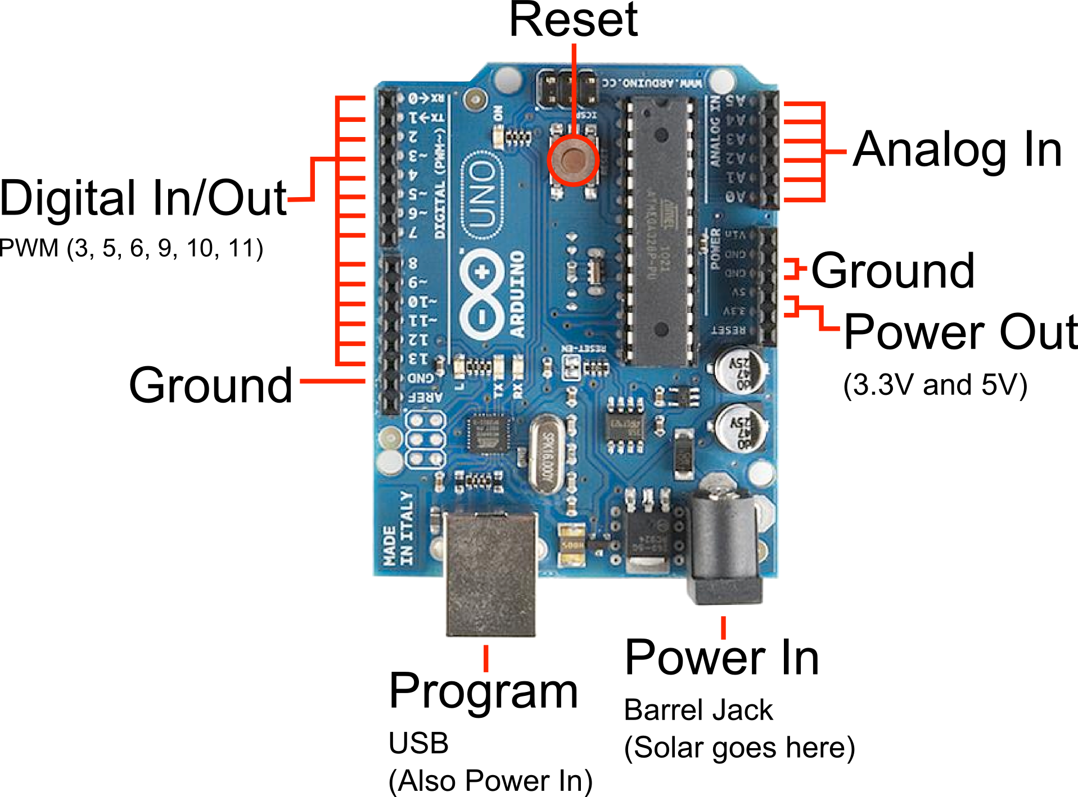
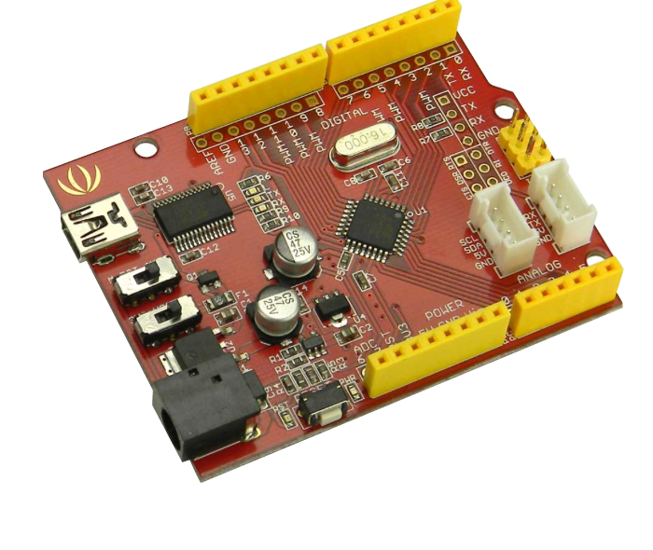
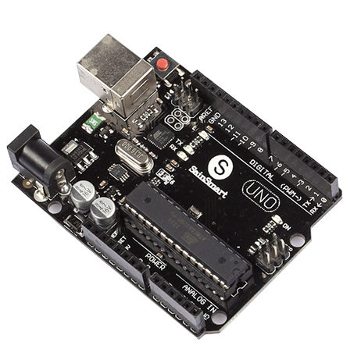
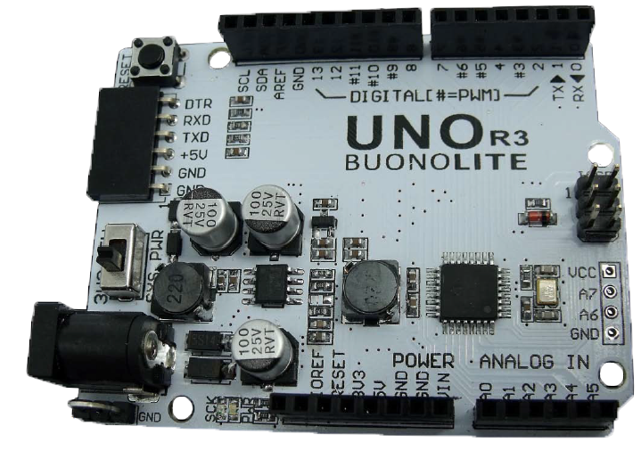
Arduino Uno – Compatibles

Slide 3



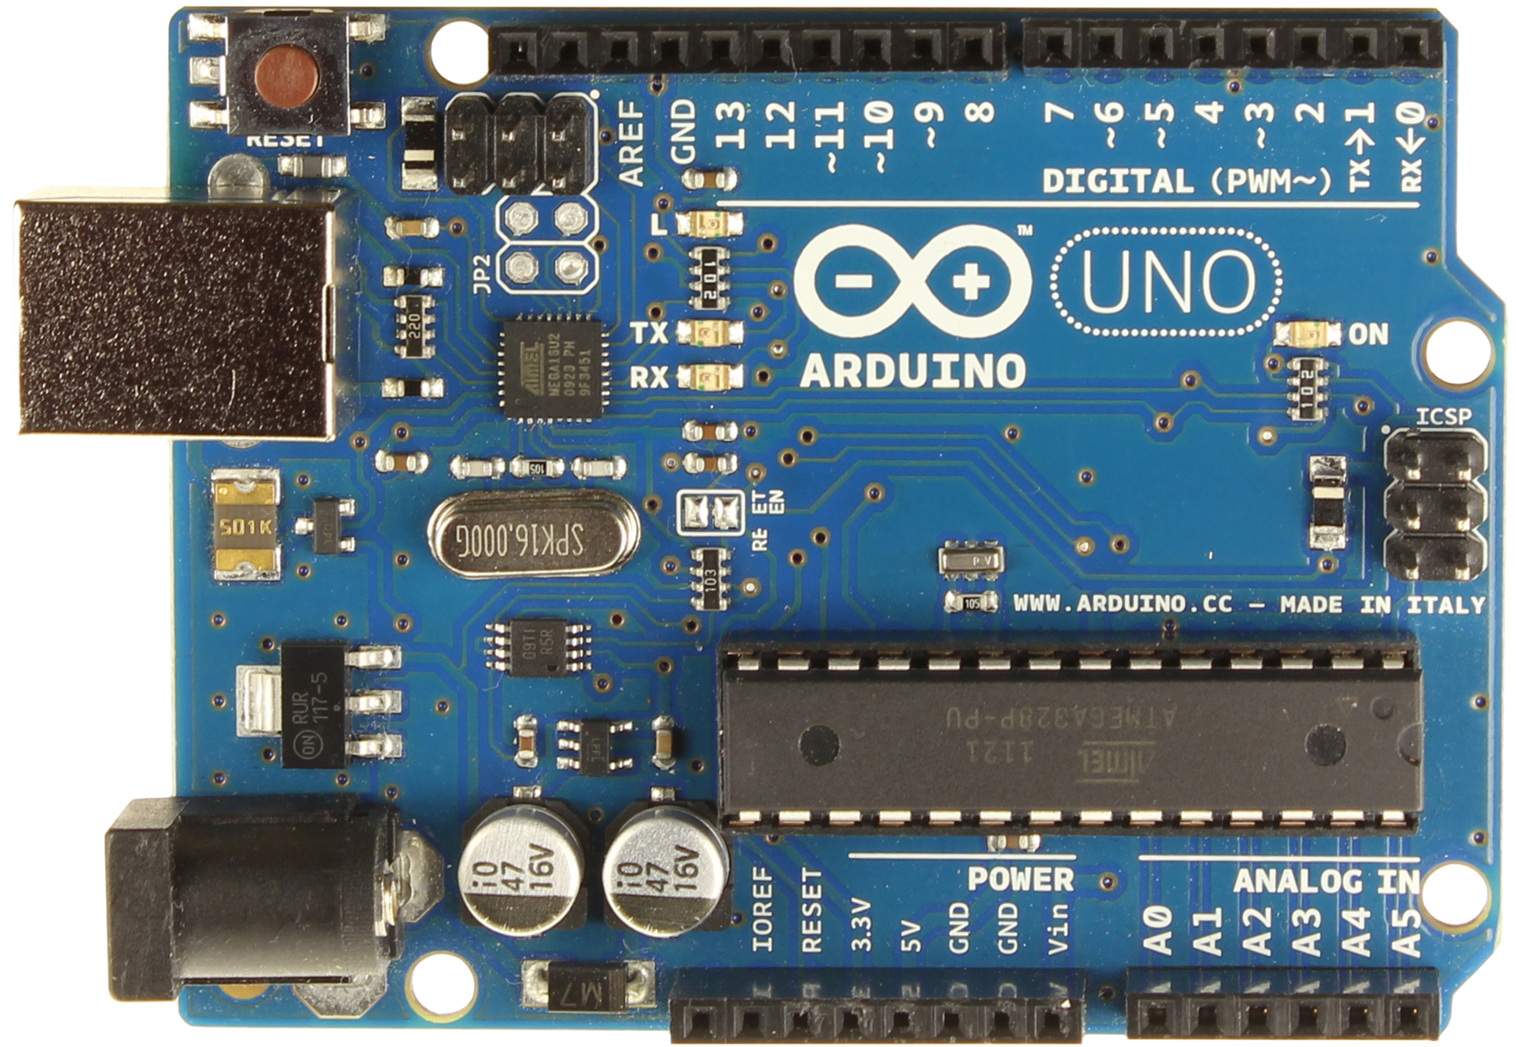


Hardware & Software
Software
Arduino IDE
• C/C++
ASM

Slide 4
Introduction to Assembly
Oldest non-machine language
Assembly is close to a one to one correspondence between symbolic instructions and executable machine codes
Assembly gives access to key machine features for low-level routines (OS kernel, microkernel, device drivers, machine control...)
High quality assembly can be 2 to 20 times faster

Slide 5
C can be close to assembly
Both can:
Access all the functions/ registers of the ATMega328
Have a decidedly smaller footprint than Arduino code.
In Assembly…
working with the program counter and the stack.
no predefined data types
working directly with addresses or pointers

Slide 6




Software Comparison
 | Arduino IDE | C/C++ | ASM
Ease of Development | Easy | Moderate | Challenging
Libraries | Many | Many | None
Speed | SLOW | Fast | FAST as Possible
Accessibility of processor features | Very Limited | Most | ALL

Slide 7
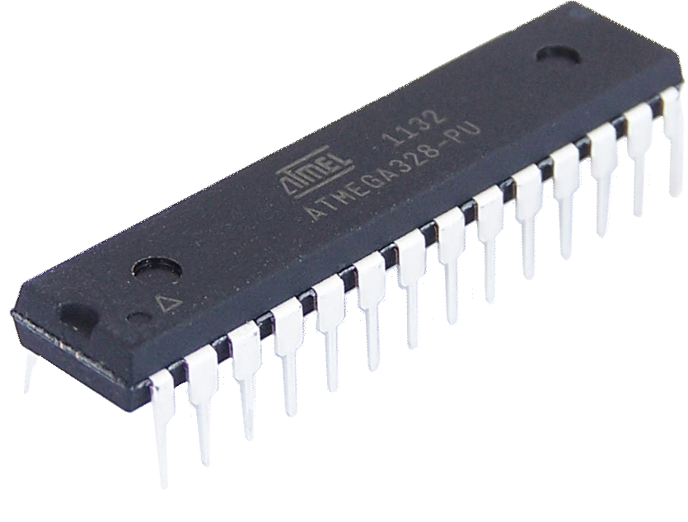
Overview of the ATMega328

Slide 8
ATMega328 Internals
AVCC
GND
RESET
XTAL[1..2]
ADC [6..7]
debugWIRE fuse
2
6
PROGRAM
LOGIC
A/D Convertor
Internal Bandgap
SRAM
PORT C
Port C [0..6]
EEPROM AREF
TWI
7
VCC
CPU
Power Supervision POR/BOD & RESET
Flash
Analog Comparator
PORT B
Port B [0..7]
16bit T/C 1
SPI
GND
8
Watchdog Timer
Watchdog Oscillator
Oscillator Circuits/ Clock Generation
8bit T/C 0
PORT D
Port D [0..7]
8bit T/C 2
USART 0
8
DATABUS

Slide 9
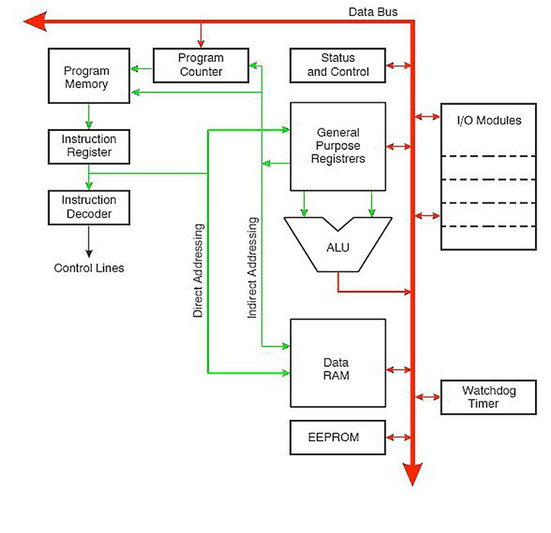
Processor Layout

Slide 10
ATMega328 Ports
DATABUS
 |  |  |  |  |  |  |  |  |  |  |  |  |  |  | Comp.
PC6 | 1 | 28 |  | PC5
PD0 PD1 | 2 3 | 27 26 |  | PC4 PC3 | Port C
PD2 PD3 | 4 5 | 25 24 |  | PC2 PC1 |  |  |  |  |  | USART 0 |  |  |  |  | SPI |  |  |  |  | TWI
PD4 | 6 | 23 |  | PC0
VCC | 7 | 22 |  | GND
GND | 8 | 21 |  | AREF
PB6 | 9 | 20 |  | AVCC
PB7 | 10 | 19 |  | PB5
PD5 | 11 | 18 |  | PB4
PD6 | 12 | 17 |  | PB3 | Port B |  |  |  |  | PORT D (8) |  |  |  |  | PORT B (8) |  |  |  |  | PORT C (7)
PD7 | 13 | 16 |  | PB2
PB0 | 14 | 15 |  | PB1
Port D
RESET
XTAL[1..2]
PD[0..7]
PB[0..7]
PC[0..6]
ADC[6..7]
bidirectional ports

Slide 11
ATMega328 Features
Low Power AVR 8bit Microcontroller
131 Powerful instructions
32x8 General Purpose Working Registers
On-chip 2-cycle Multiplier
Non-volatile Memory Segments
32Kb Self-Programmable Flash program memory
1Kb EEPROM
2Kb Internal SRAM

Slide 12
Arithmetic Logic Unit (ALU)
Directly connected to all 32 general purpose registers
Operations between registers executed within a single clock cycle
Supports arithmetic, logic and bit functions
On-chip 2-cycle Multiplier

Slide 13


Arduino MCU Register
0x00 | R0
0x01 | R1
0x02 | R2
0x0D | R13
0x0E | R14
0x0F | R15
0x10 | R16
0x11 | R17
0x1A | R26 | X-register | Low byte
0x1B | R27 | X-register | High byte
0x1C | R28 | Y-register | Low byte
0x1D | R29 | Y-register | High byte
0x1E | R30 | Z-register | Low byte
0x1F | R31 | Z-register | High byte
...
...
...
...

Slide 14
Memory Mapped I/O Space
I/O registers visible in data space
I/O can be accessed using same instructions as data
Compilers can treat I/O space as data access
Bit manipulation instructions
Set/Clear single I/O bits
Only work on lower memory addresses

Slide 15







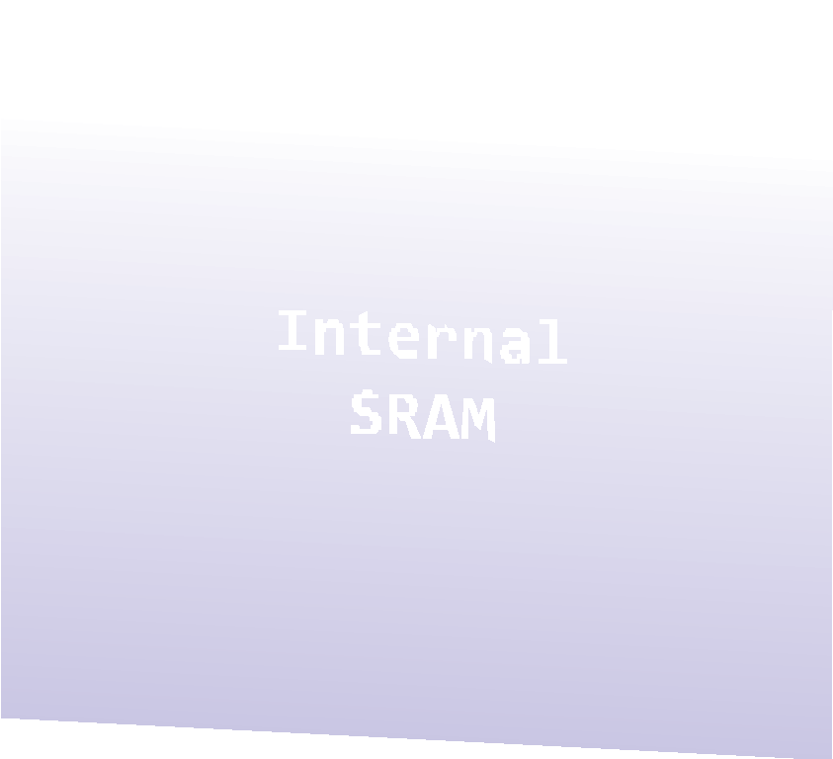
Memory Map
0x0000 0x0020 | -­‐ -­‐ | 0x001F 0x005F
0x0060 | -­‐ | 0x00FF
0x0100 -­‐ 0x08FF

Slide 16



I/O Addresses
Address Range |  |  | Purpose
0x0100 | -­‐ | 0x08FF | 2K SRAM (general purpose RAM)
0x0020 | -­‐ | 0x00FF | Memory Mapped I/O
0x0000 | -­‐ | 0x001F | Registers r0 -­‐ r31
I/O Address | Memory Address | Designation
0x03 0x04 0x05 | 0x0023 0x0024 0x0025 | PINB -­‐ DDRB -­‐ PORTB | input, port B data direction, -­‐ output, port B | port | B
0x06 0x07 0x08 | 0x0026 0x0027 0x0028 | PINC -­‐ DDRC -­‐ PORTC | input, port C data direction, -­‐ output, port C | port | C
0x09 0x0A 0x0B | 0x0029 0x002A 0x002B | PIND -­‐ DDRD -­‐ PORTD | input, port D data direction, -­‐ output, port D | port | D

Slide 17
131 Instructions
Arithmetic & Logic
Branch
Bit set/clear/test
Data transfer
Microcontroller control

Slide 18
Instruction Timing
Register -> register (1 cycle)
Register -> memory (2 cycles)
Branch instruction (1-2 cycles)
Subroutine call & return (3-5 cycles)
Some operations may take longer for external memory

Slide 19
Clock System - Timers/Counters
Clock control module generates clocks for memory and IO devices
Multiple internal clock sources
Default is only 5-10% accurate

Slide 20
Timers/Counters
8/16 Bit register
Increments or decrements on every clock cycle
Can be read on data bus
Output feeds waveform generator
Clock Sources
Internal from clock prescaler
External Tn Pin (Uses 1 port pin)

Slide 21
Interrupts
ATmega328 has 26 reset/interrupt sources
1 Reset source
2 External interrupt sources
I/O Pin state change on all 24 GPIO pins
Peripheral device events

Slide 22
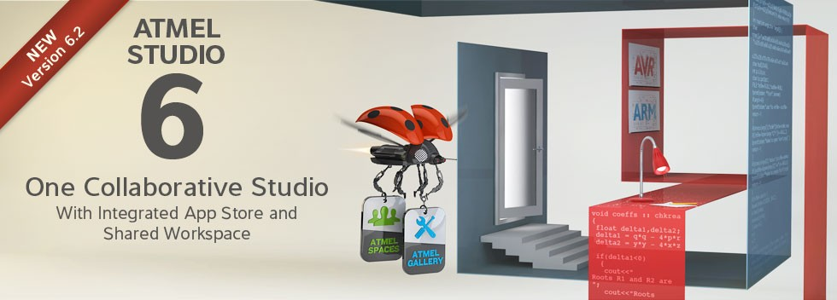
AVR Studio/Toolchain
Slick integrated environment (Windows)
Directly incorporates Assembly
Requires knowledge of the bootloading process
For power users.

Slide 23
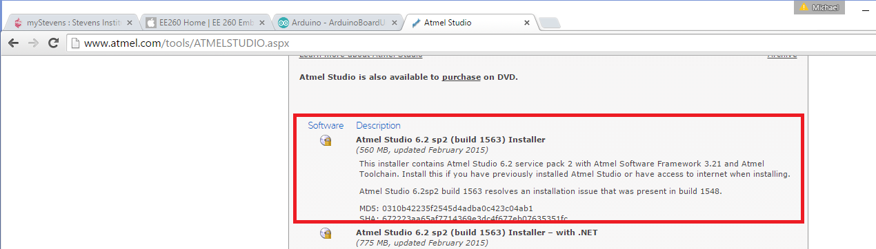
Atmel Studio Setup Instructions
Visit the Atmel Studio 6.2 download page at:
http://www.atmel.com/tools/ATMELSTUDIO.aspx
Once, downloaded, run the installer
You may be prompted to download Microsoft Visual Studio Isolated Shell 10.0

Slide 24
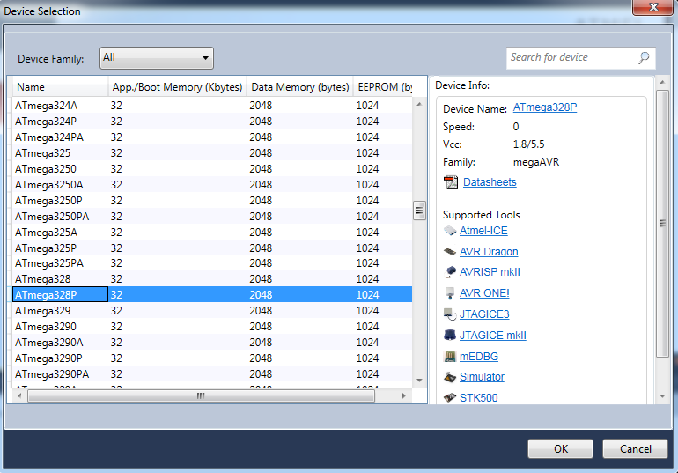
Create a new assembler project
Open Atmel Studio
Click “File” -> “New” -> “Project”, select “Assembler” -> “AVR Assembler Project” and click “OK” to create a new project.
In “Device Selection” Window, choose “ATmega328P” device and click “OK”.

Slide 25
Setting up the Arduino Assembly
The Arduino IDE doesn’t directly allow assembly
A number of approaches exist to do assembly with the Arduino IDE:
Modify the IDE
“Inline” Assembly

Slide 26
Inline Assembly
Allows for all the assembly commands and structures.
Requires a lot of extra stuff in the code to support the program that is not a part of the program
more difficult to read/debug

Slide 27
Inline Assembly Example Line
asm("in %0, %1 \n\t” : "=r" (value) : "I" (_SFR_IO_ADDR(PORTD)) );
asm(…) indicates to the IDE that assembly is used
The assembler instruction is defined as a single string constant: "in %0, %1 \n\t”
The list of output operands follow, separated by commas.
"=r" (value)
Next, a comma separated list of input operands.
"I" (_SFR_IO_ADDR(PORTD))

Slide 28
Assembly
Begin:
 | add | R16, | R17 | ; | Add R17 into R16
 | dec | R17 |  | ; | Decrement the value contained in R17
 | mov | R18, | R16 | ; | Copy the value in R16 to R18
END: | jmp | Begin |  | ; | Jump to the label END
Column 1 used for labels.
Column 2 used for the instruction/directive
[Column 3 used for operands]
Column 4 used for comments

Slide 29
Operand Forms
Rd | Destination (& source) register R0-­‐R31 or R16-­‐R31
Rr | Source register R0-­‐R31
b | Bit in the Register file or I/O Register (3-bit constant)
s | Bit in the Status Register (3-bit)
X,Y,Z | Indirect Address Register (X=R27:R26, Y=R29:R28, Z=R31:R32)
K | Constant data
k | Constant Address
A | I/O location address
q | Displacement for direct addressing (6-bit)
PC | Program Counter

Slide 30



Operators
Symb | Name | Returns | Priority
! | Logical Not | 1 if the expression is 0, 0 otherwise | 14
~ | Bitwise Not | all bits inverted | 14
-­‐ | unary minus | the arithmetic negation of expression | 14
* | multiplication | the product of the two expressions | 13
/ | division | the integer quotient (1st exp)/(2nd exp) | 13
+ | addition | the sum of the two expressions | 12
-­‐ | subtraction | the difference (1st exp) – (2nd exp) | 12
<< | shift left | the (1st exp) shifted to the left by the (2nd exp) | 11
>> | shift right | the (1st exp) shifted to the right by the (2nd exp) | 11
< | less than | 1 if the (1st exp) is less than the (2nd exp), 0 else | 10

Slide 31

Operators
Symb | Name | Returns | Priority
<= | less or equal | 1 only if the (1st exp) is less or equal to the (2nd exp) | 10
> | greater than | 1 if the (1st exp) is greater than the (2nd exp), 0 else | 10
>= | greater or equal | 1 only if the (1st exp) is greater or equal to the (2nd exp) | 10
== | equal | 1 if the (1st exp) is equal to the (2nd exp), 0 else | 9
!= | not equal | 1 if the (1st exp) is not equal to the (2nd exp), 0 else | 9
& | bitwise AND | the bitwise AND of two expressions | 8
^ | bitwise XOR | the bitwise XOR of two expressions | 7
| | bitwise OR | the bitwise OR of two expressions | 6
&& | logical AND | true only if both operands are true | 5
|| | logical OR | true if either operand is true | 4

